Slide 1

Classification (Logistic Regression & SVM)
by:
Eng. Alaa Al Nissany

Slide 2
Machine Learning
Supervised Learning
Unsupervised Learning
Reinforcement Learning
Classification
Clustering
Q-Learning
Regression
Anomaly Detection
DQN
Ranking
Dimensionality reduction

Slide 3
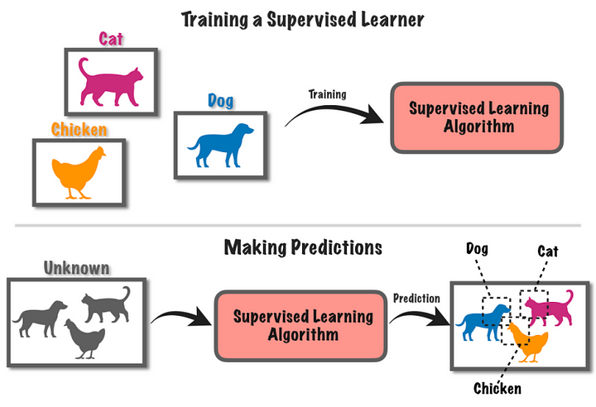
Supervised Learning

Slide 4
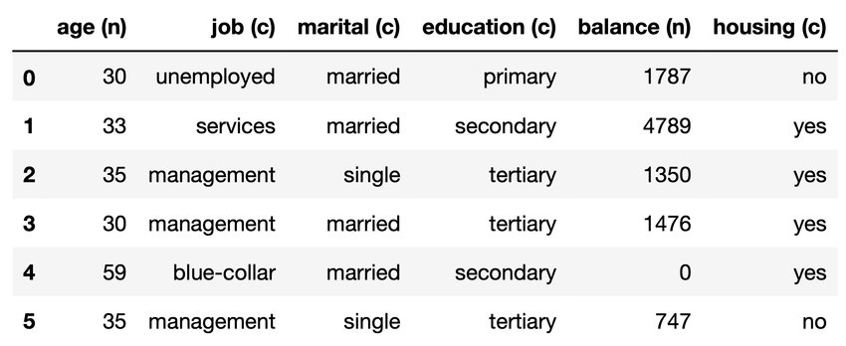
Tabular data
Target Or Label
Or
Response variable
Or
Dependent variable
Features Or Attributes Or Independent variables
Observations Or
Records
Or
Samples

Slide 5
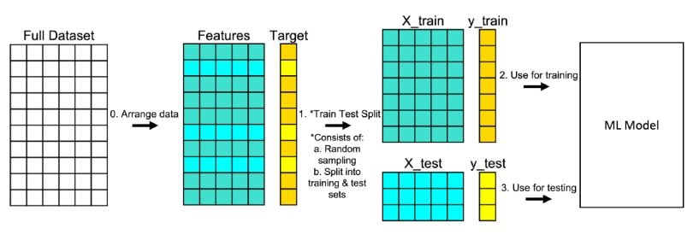
Train vs test Split

Slide 6
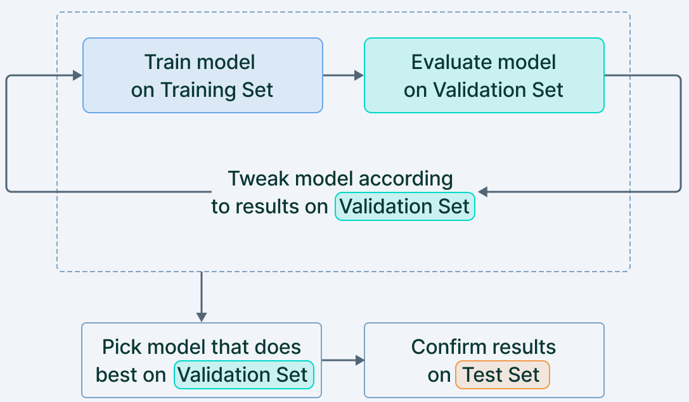
Train vs test vs validation Sets

Slide 7

Evaluation on the validation set (Cross Validation)

Slide 8
Variables types
DATA
The data can only be categorized
Numerical (Quantitative)
Categorical (Qualitative)
The data has an arbitrary Zero-point.
Continuous
Discrete
Nominal
Ordinal
Interval
Ratio
The data can be categorized and ranked
The data has an absolute zero or character of origin.
https://www.questionpro.com/blog/ratio-scale-vs-interval-scale/

Slide 9
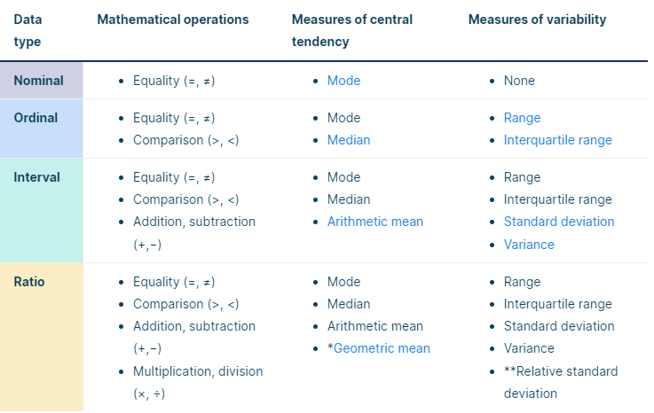
https://www.scribbr.com/statistics/levels-of-measurement/

Slide 10
Dimensionality
1D data (there is Only one feature) | 2D data (there is Two features) | 3D data (there is Three features)
Tall
Tall
Tall
Wight
Wight
Age

Slide 11
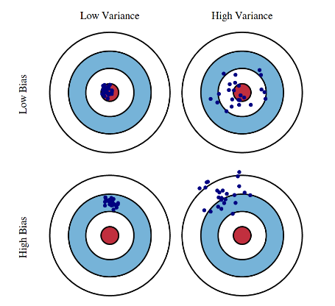
Bias and Variance

Slide 12
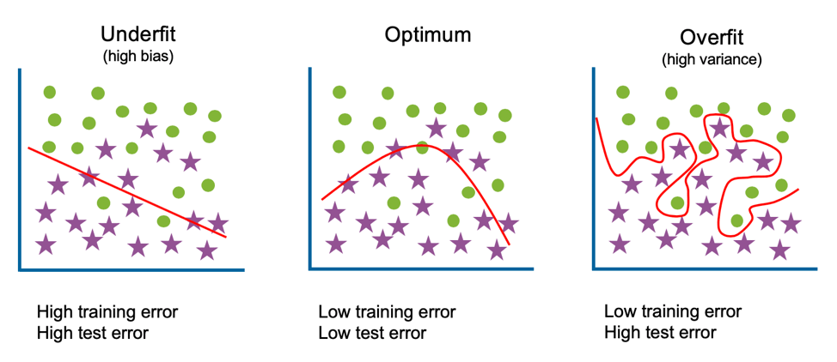
Over-fitting vs under-fitting

Slide 13
Classification

Slide 14
Decision boundary in k-dimensions data
1D data (there is Only one feature) | 2D data (there is Two features) | 3D data (there is Three features)
Tall
Tall
Tall
Class 1
Wight
Wight
Class 2
Age

Slide 15
Binary Classification vs Multi-Class Classification
Binary Classification | Multi-Class Classification
Tall
Class 1
Class 2
Tall
Class 3
Wight
Wight
Age
Age

Slide 16

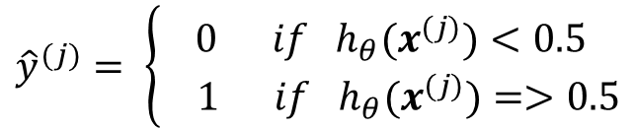
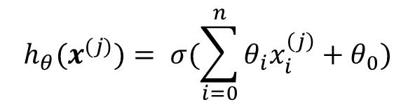
Logistic regression
$$h_{θ}$$
$$h_{θ}(x^{(j)})= σ(\sum_{i=0}^{n}{θ_{i}x_{i}^{\left(j\right)}}+θ_{0})$$
$${\hat{y}}^{(j)}= \left\{\begin{aligned}0 if{ h}_{θ}(x^{(j)})<0.5 \\ 1 if h_{θ}(x^{(j)})=>0.5\end{aligned}\right.$$

Slide 17
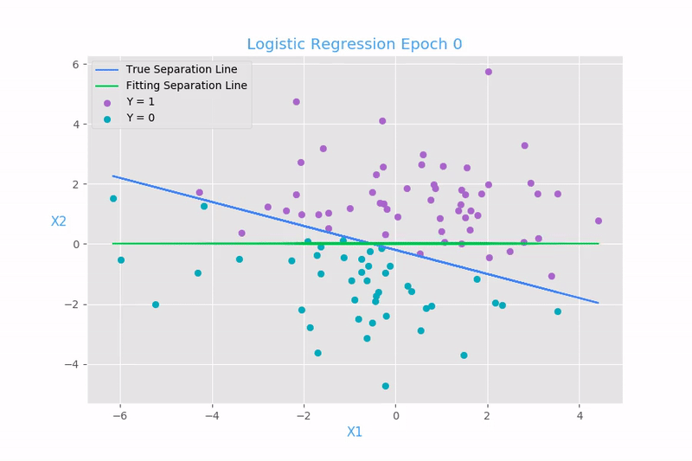
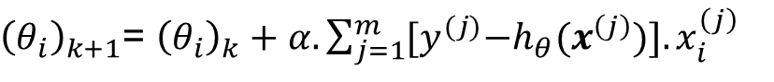
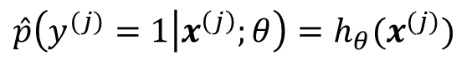
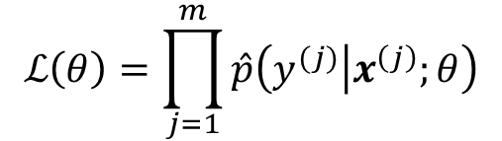
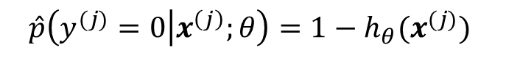
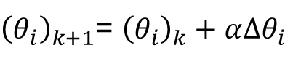
Logistic regression
$$\hat{p}\left(y^{(j)}=1 | x^{\left(j\right)};θ\right)=h_{θ}(x^{(j)})$$
$$\hat{p}\left(y^{(j)}=0 | x^{\left(j\right)};θ\right)=1−h_{θ}(x^{(j)})$$
$$\hat{p}\left(y^{(j)} | x^{\left(j\right)};θ\right)={{[h}_{θ}\left(x^{\left(j\right)}\right)]}^{y^{(j)}}{[1−h_{θ}\left(x^{\left(j\right)}\right)]}^{1−y^{(j)}}$$
$$ℒ\left(θ\right)=\prod_{j=1}^{m}{\hat{p}\left(y^{(j)} | x^{\left(j\right)};θ\right)}$$
${\left(θ_{i}\right)}_{k+1}$= ${\left(θ_{i}\right)}_{k}+α.\sum_{j=1}^{m}{{[y}^{(j)}−h_{θ}(x^{\left(j\right)})].x_{i}^{\left(j\right)}}$
${\left(θ_{i}\right)}_{k+1}$= ${\left(θ_{i}\right)}_{k}+α∆θ_{i}$

Slide 18
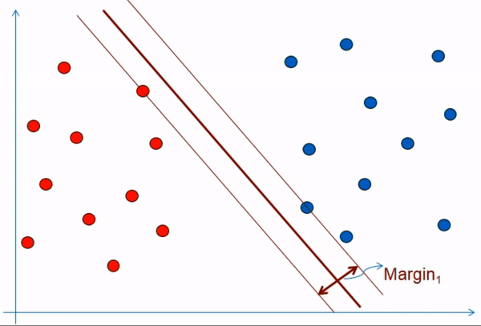
Support Vector Machines

Slide 19
Support Vector Machines
Tall
https://youtu.be/efR1C6CvhmE?si=vM-BReY9otlmOTsO

Slide 20
Support Vector Machines
Tall
https://youtu.be/efR1C6CvhmE?si=vM-BReY9otlmOTsO

Slide 21
Support Vector Machines
Tall
https://youtu.be/efR1C6CvhmE?si=vM-BReY9otlmOTsO

Slide 22
Support Vector Machines
Maximum Margin Classifier
Tall
Margin
https://youtu.be/efR1C6CvhmE?si=vM-BReY9otlmOTsO

Slide 23
Support Vector Machines
Tall
https://youtu.be/efR1C6CvhmE?si=vM-BReY9otlmOTsO

Slide 24
Support Vector Machines
Tall
Soft Margin Classifier
Or
Support Vector machines Classifier
https://youtu.be/efR1C6CvhmE?si=vM-BReY9otlmOTsO

Slide 25
Support Vector Machines
Tall
https://youtu.be/efR1C6CvhmE?si=vM-BReY9otlmOTsO

Slide 26
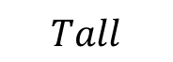
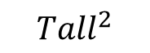
Kernels
$${Tall}^{2}$$
$$Tall$$
https://youtu.be/efR1C6CvhmE?si=vM-BReY9otlmOTsO

Slide 27

Thank you for listening

Slide 28
Any Questions
?

